Slide 1
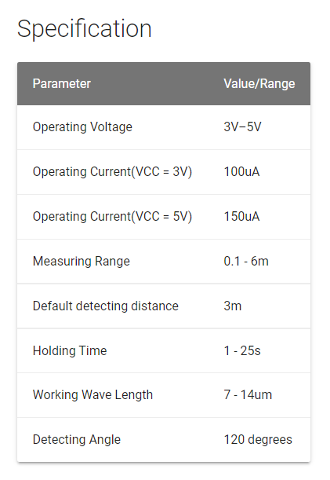
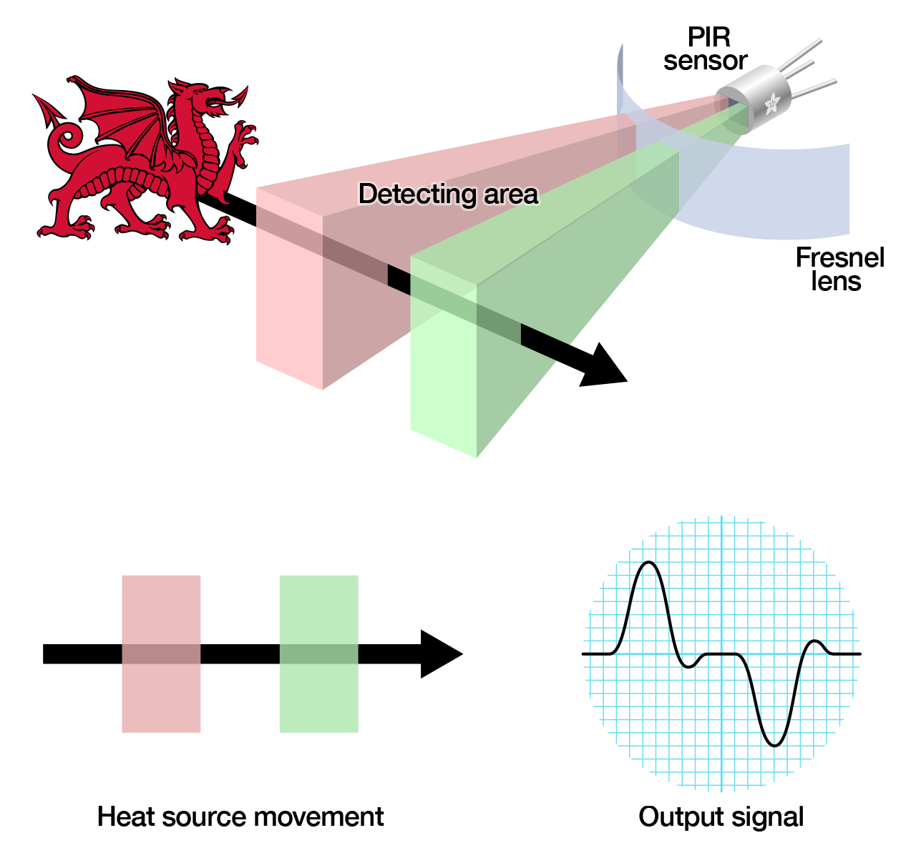
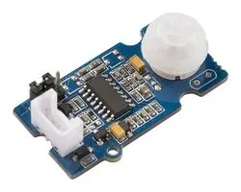
Individual design of sensors board
Grove PIR motion sensor
(Passive Infrared Sensor)
The inferred is from the things which can create heat.
PIR motion sensor can detect the inferred and output a signal HIGH, otherwise output a 0.
Picture source: https://learn.adafruit.com/pir-passive-infrared-proximity-motion-sensor/how-pirs-work

Slide 2
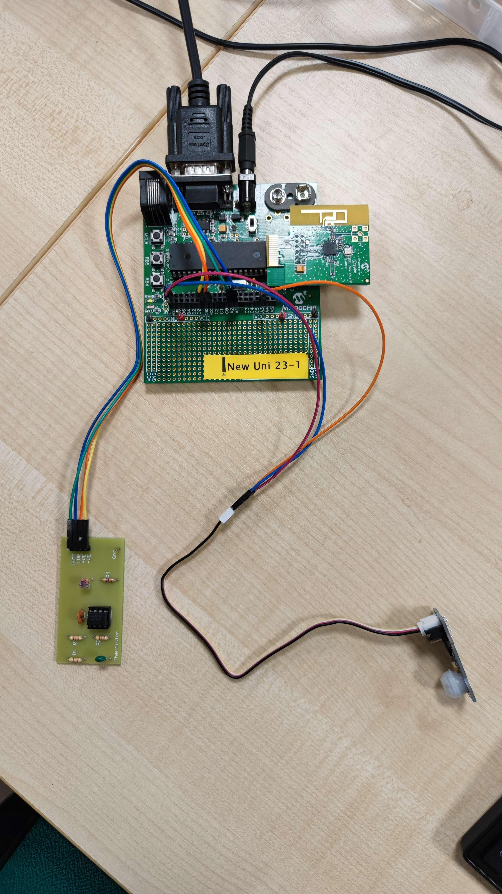
Individual design of sensors board
The motion sensor has 4 pins and 4 cables.
Motion sensor board pin (Color of the cable from it) | PIC18F4620 board pin
VCC(Red) | VCC
GND(Black) | GND
Not connected(White) | N/A
D(Yellow) | A3
Grove PIR motion sensor
(Passive Infrared Sensor)
Connect the sensor board interfaces correctly

Slide 3
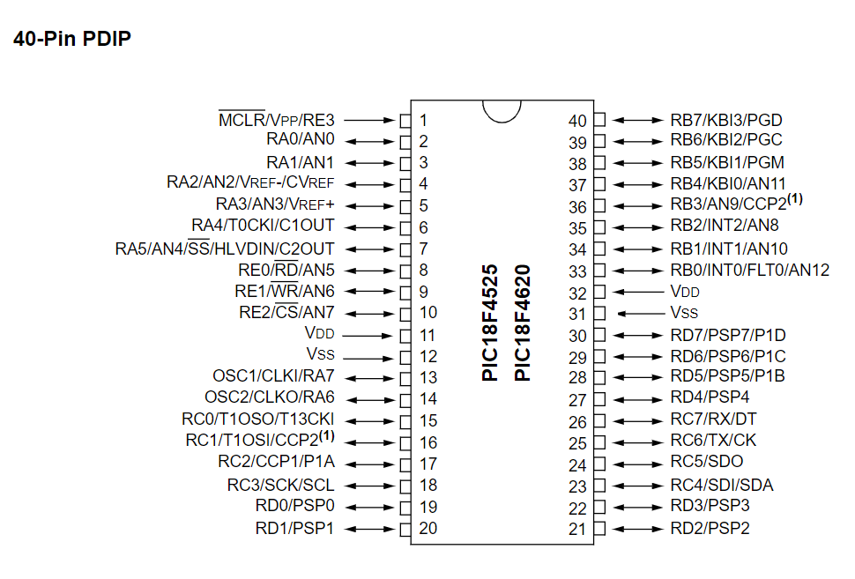
Individual design of sensors board
Use AN3 pin to transmit the signal to ADC from the PIR motion sensor
Source: PIC18F micor chip datasheet

Slide 4
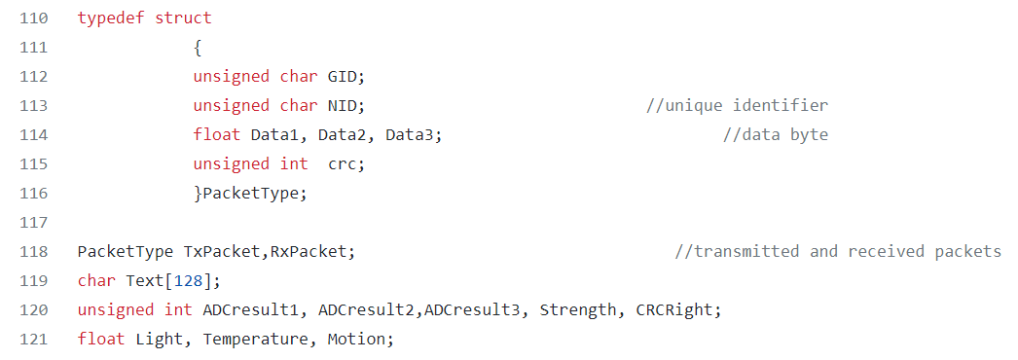
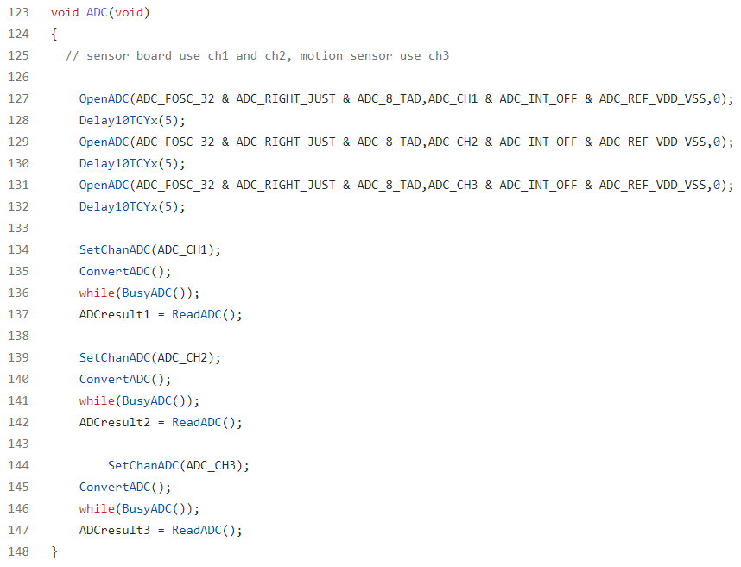
Individual design of sensors board
Partly code for PIC18F4620 and MRF24J40
(ADC and Zigbee communication)
kashyu/g23 (github.com) my code repository
Define the variables here.
Then, set CH3 and transmit messages via it.

Slide 5
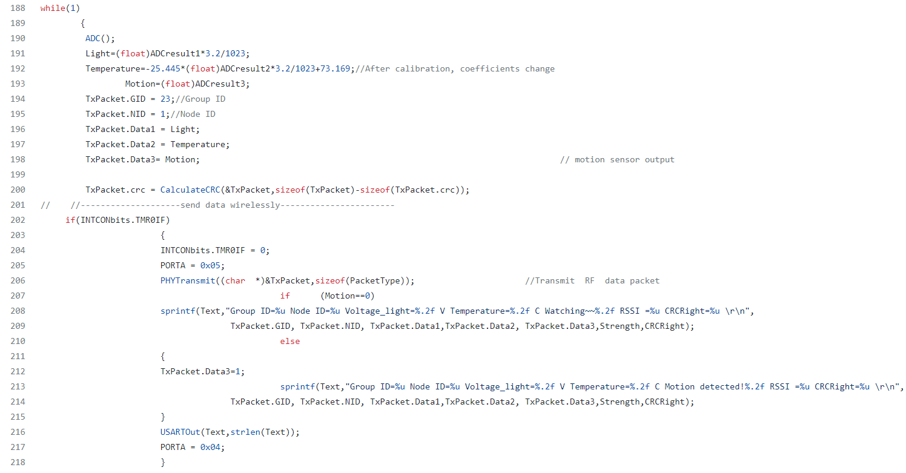
Individual design of sensors board
partly code for PIC18F4620 and MRF24J40
(ADC and Zigbee communication)
kashyu/g23 (github.com) my code repository
Here the output signal HIGH is a four-bit data with a value of more than 6000. Actually, we don’t need this value. It is enough to transmit a 1 to represent the signal HIGH.

Slide 6
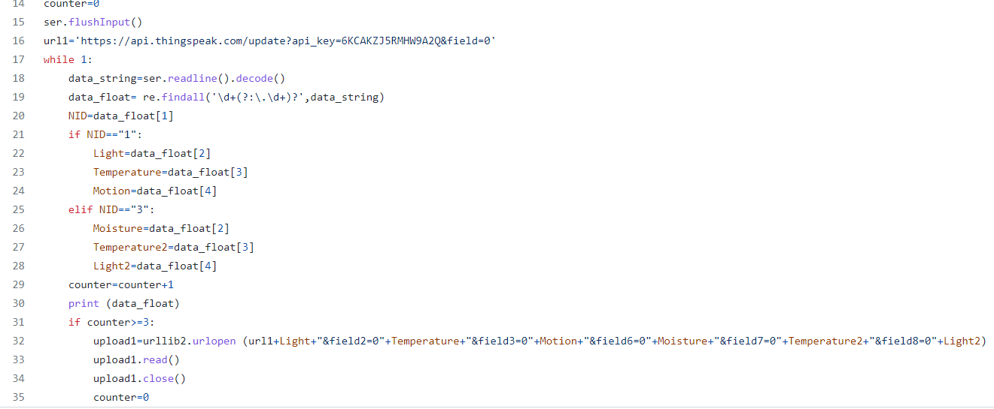
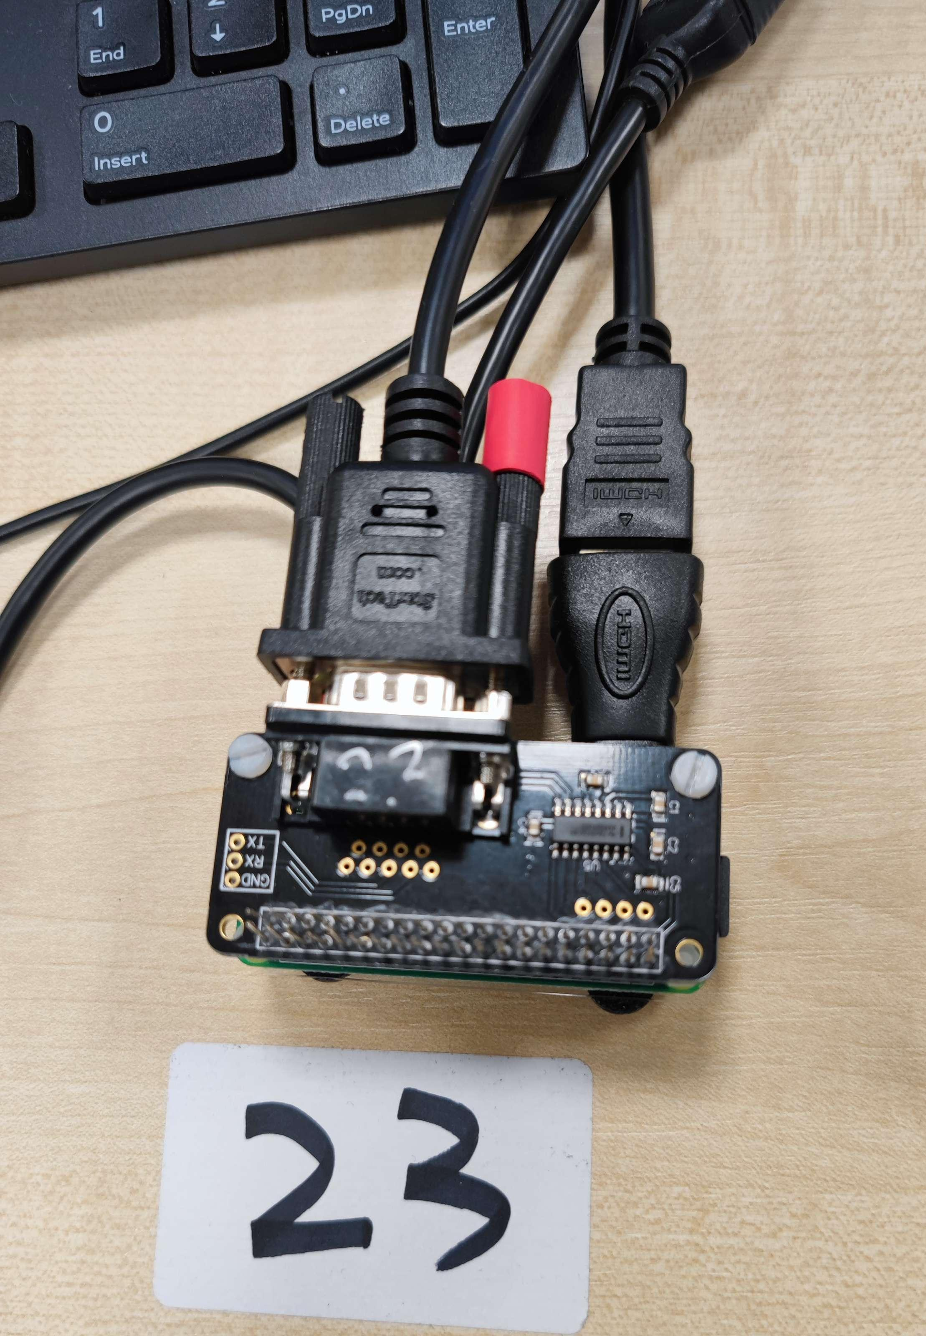
Individual design of sensors board
Partly code for Raspberry Pi
kashyu/g23 (github.com) my code repository
The data would be sent to Thingspeak and figured in the Field 3 Chart.

Slide 7
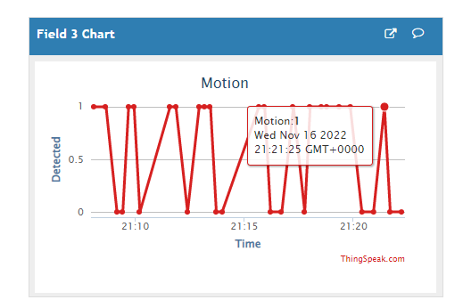
Individual design of sensors board
Thingspeak
Signal 0s and 1s are transmitted via WIFI to the Thingspeak platform.
0 means rest.
1 means detected.

